Slide 1

Expedient, fast, and fun for the whole family!

Slide 2

What is locatiles?
A customer in a store should be able to locate items easily.
Locatiles provides a solution to this problem!

Slide 3
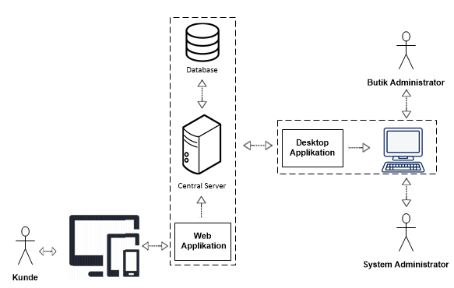
What is locatiles?
Web App
Administrative Desktop Application
Database

Slide 4
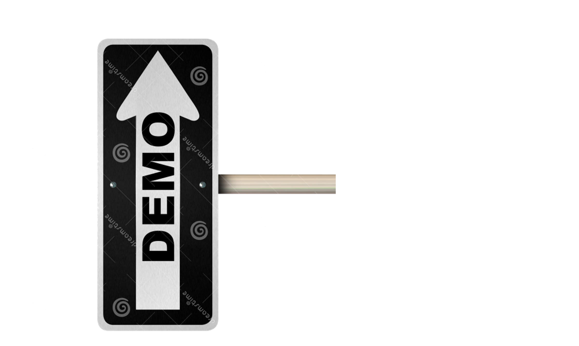
Demonstration

Slide 5


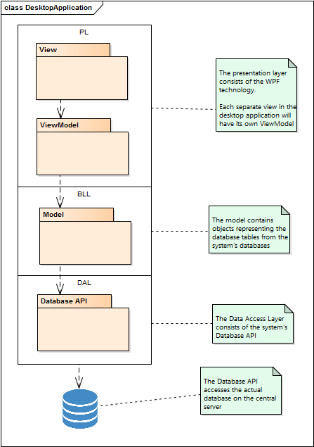
mvvm

Slide 6
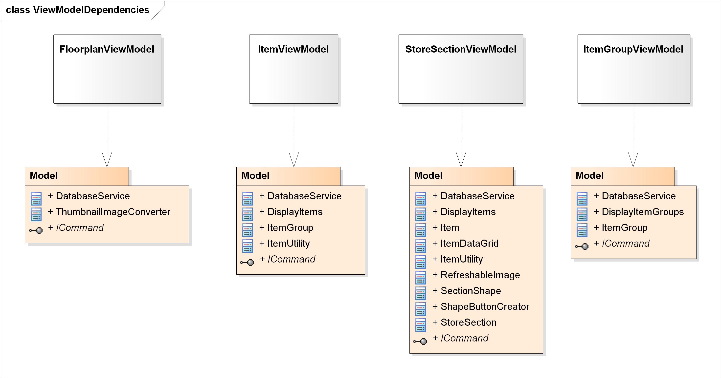
ViewModels

Slide 7
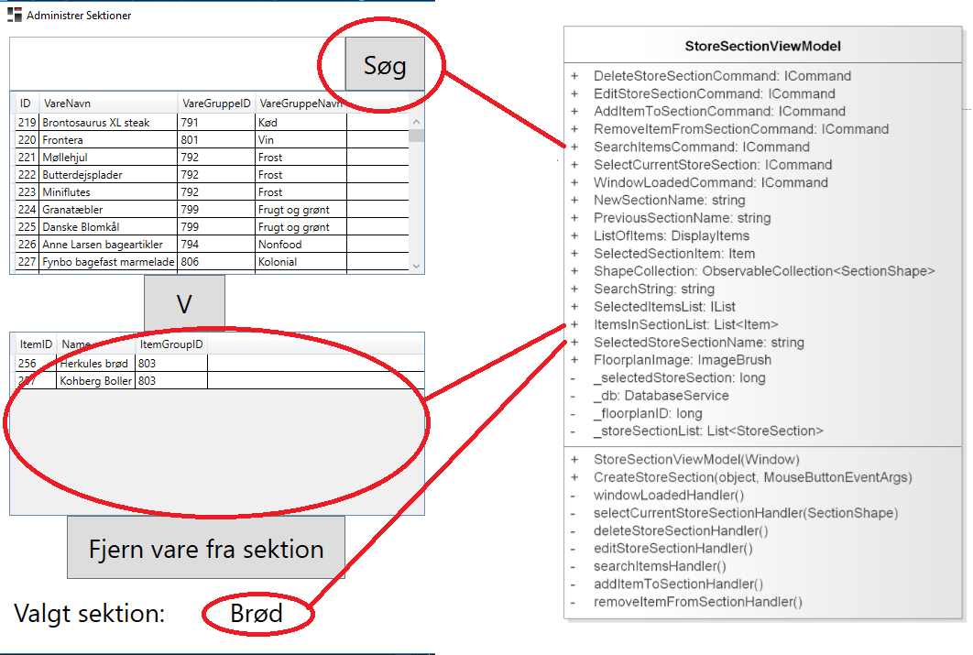
bindings

Slide 8
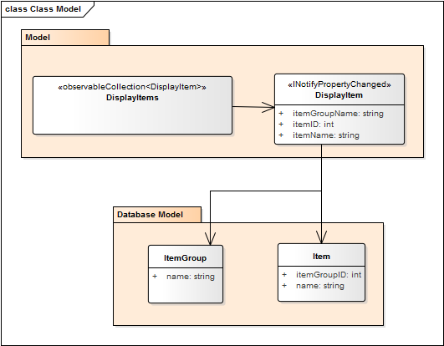
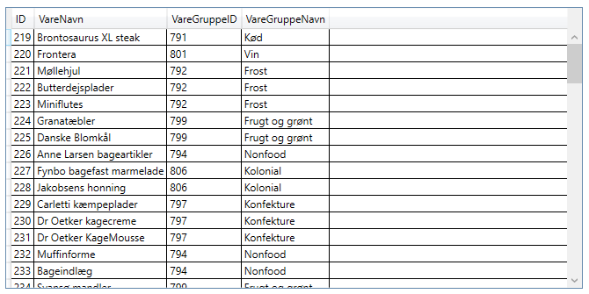
difficulties

Slide 9
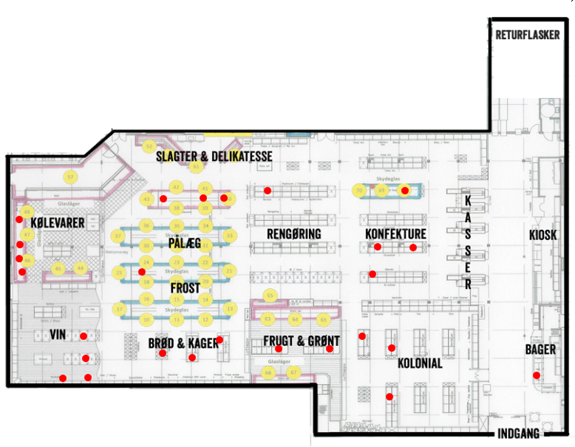
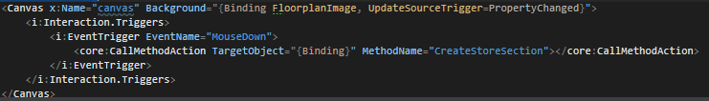
Difficulties

Slide 10

Benefits
Great separation in workflow
One can work on viewmodel logic while another works on UI
Great separation between windows
You can delegate entire windows to group members
Testability
Integration tests

Slide 11
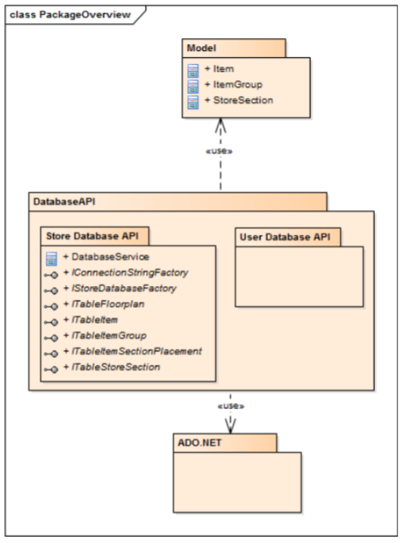

Slide 12
